Slide 1
A short introduction to PyGame
JR Rickerson

Slide 2
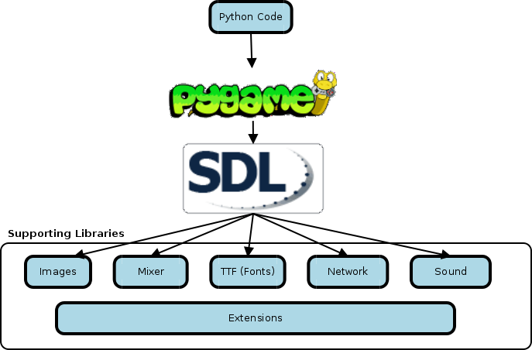
What is PyGame?

Slide 3
Getting set up (Ubuntu)
Install SDL package: libsdl
Install necessary supporting packages: libsdl-image, libsdl-ttf, libsdl-mixer
Install pygame: python-pygame
Test it out:
$ python
>>> import pygame

Slide 4
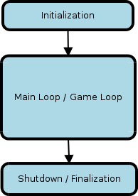
Structure of a game

Slide 5
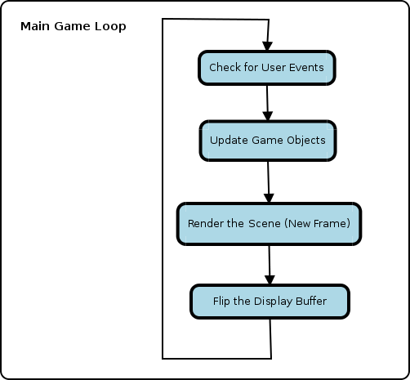
Inside the Main Loop

Slide 6
Writing the Code
Part 1: Keep it simple – Getting a window and an image to display on the screen.

Slide 7
Writing the Code
Part 1: Keep it simple – Getting a window and an image to display on the screen.
Part 2: Get things moving – Handling user input.

Slide 8
Writing the Code
Part 1: Keep it simple – Getting a window and an image to display on the screen.
Part 2: Get things moving – Handling user input.
Part 3: Adding purpose – Creating the bad guys.

Slide 9
Writing the Code
Part 1: Keep it simple – Getting a window and an image to display on the screen.
Part 2: Get things moving – Handling user input.
Part 3: Adding purpose – Creating the bad guys.
Part 4: Making it a game – Scores and losing conditions.

Slide 10
Adding polish to your game
Enhance the game with sound and music
Create intro and exit screens
Track scores between games
Add basic animations
Tweak gameplay (speed, power ups, achievements, etc.)

Slide 11
Resources
PyGame Documentation
http://www.pygame.org
SDL Documentation
http://www.libsdl.org
“Invent Your Own Computer Games with Python”
http://inventwithpython.com
Katie Cunningham's website
http://therealkatie.com

